Slide 1
TalkingData mobile user demographics
Kaggle Competition Analysis and Insights

Slide 2

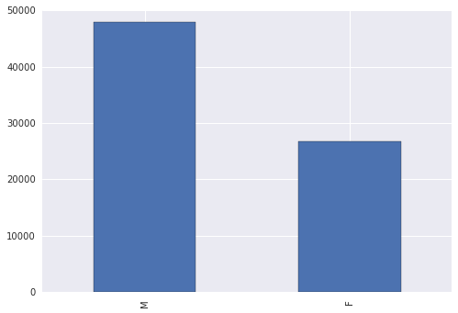
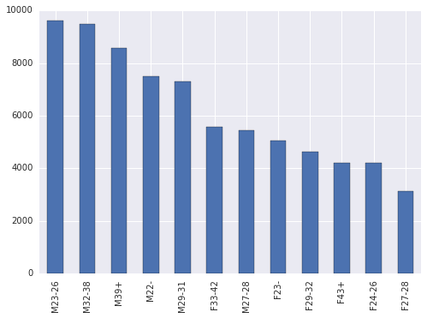
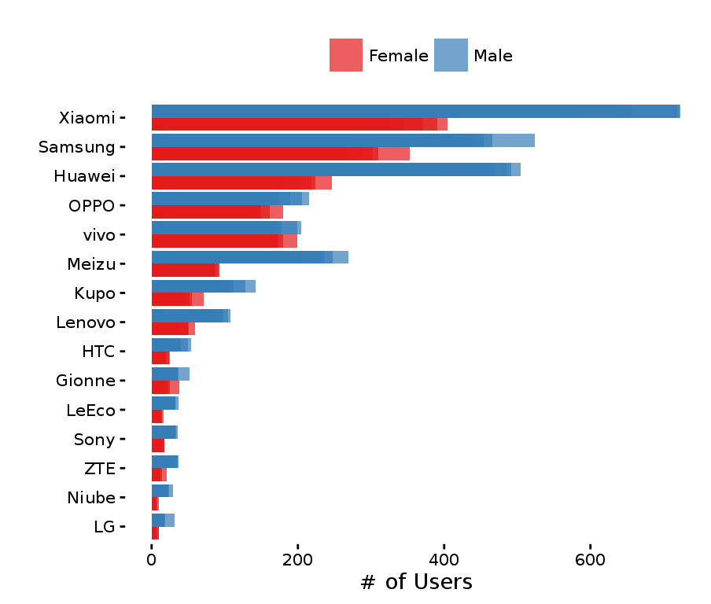
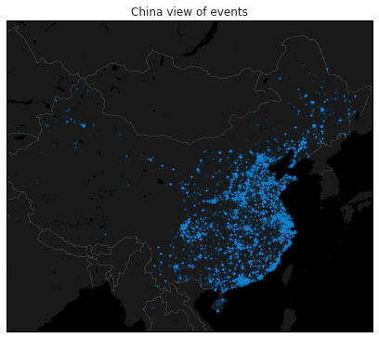
Overview
Mobile app analytics and advertising
Embedded 120,000 apps
In 70% of China’s 500m mobile devices
Predict age and gender based on
App usage
931 categories
Device location
Latitude & longitude
Brand & model
$25k prize money

Slide 3
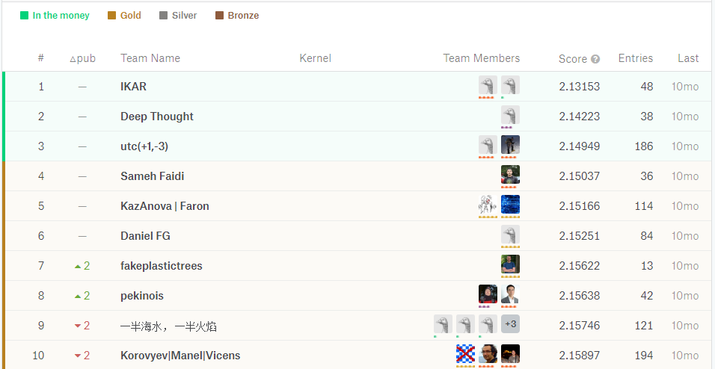
Competition
Provided Data
Training Data: 74,645 devices
Test Data: 112,071 devices (no age/gender)
Evaluation
Submit probability for each gender/age class
Multi-class logarithmic loss
Public leader board during competition
Private leader board for final prizes
Approaches
Neural Networks
Logistic Regression
XGBoost

Slide 4
Data Leakage

